Slide 1
My Number 17!
(with fun facts, problems, and Much Much More)

Slide 2
Equations With My Number
205 + ? = 222 | For this equation number 17 is
205 + 17 = 222 | is the unknown addend
1056 - ? = 1039 | for this equation 17 is the
1059 – 17 = 1039 | unknown subtracthen
? X 50 = 850 | For this equation 17 is the
17 X 50 = 850 | unknown factor
153 Divided by ? = 9 | For this equation 17 is the
153 divided by 17 = 9 | unknown divisor

Slide 3
Word problems (answers on back page)
1. 2.
Alicia has 5 peaches. Mezine has 38 red pens.
Her friend Nick gave her She decides to give 21 red
12 more peaches. pens to charity. How many
how many does Alicia does she have left?
have now?
3. 4.
Mazy has a rubic cube. Madison has 102 books.
It has a length of 1 inch, a She haves 6 Shelby shelfs
width of 17 inches and a to put the books on. How
height of 1 inch. What is the volume many books are on each
of the cube? shelf?

Slide 4
Multi Step Problems with my Favorite Number!
Charlotte has 49 igneous rocks. 2 weeks later she gets 2 more of them. She wants to put them on shelfs. Only 3 rocks per shelf. How many shelfs should there be?
Answer on back page can you solve it?
Tally has 133 rubber balls . She gets three more the next day. 1/8 of her balls are red. How many rubber balls are red?
Answer on back page
can you solve it?

Slide 5
Factor Pairs and Patterns with number… 17!
Factor Pairs:
1,17
Number 17 is an odd number. All of its factors are one and its self, so it is a prime number.
The multiples of 17 are:
1=17 2= 34 3=51 4= 68 5= 85
6= 102 7= 119 8= 136 9= 153
Patterns (the answer number 17 must 5 fifth in expression):
5+2+1+2+7+5+2+1+2+7
5+2+1+2= 10 10+7= 17!
The answer 17 is fifth term in the expression!

Slide 6
Written Words for Number 17 (in different languages)
Spanish for number 17 is: De Diecisete
Portuguese for number is: Dezessete
Zulu for number 17 is: Nesikhombisa
Lithuanian for number 17 is: septyniolira

Slide 7
Fun Facts with my favorite number!
1. A haiku poem is exactly 17 syllables! Cool right?
2. Ohio became the 17th state!
3. A heptadecagon has seventeen sides!
Example of a haiku poem:
Seventeen is the best
Luckiest number in the world
Seventeen has heart

Slide 8
Answer Sheet
Word problems answers Multi Word Problem answers:
1. Answer: 17 peaches 1. Answer: 17 igneous rocks
2. Answer: 17 pens 2. Answer: 17 red rubber balls
3. Answer: 17 in squared
4. Answer: 17 on each shelf

Slide 9
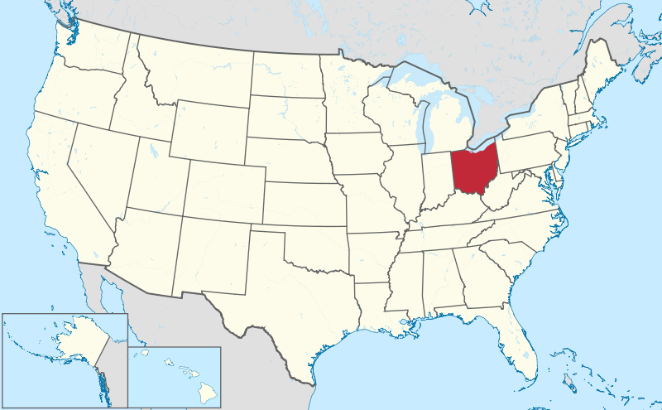
Final Product
Last but not least I'm going to explain how I got my fav number 17. I got it by entering a new team for soccer. So I thought new team new number. The first time I wore 17 was the first time I scored a goal for my team. It was great and it was the game winning goal. My soccer career had took off from that point on. Hope you enjoyed!
THANKS FOR WATCHING!

